Slide 1
Volume of composite shapes

Slide 2
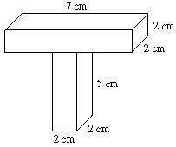
Find the volume of the shape below.
V of top = 28 cm³
V of bottom = 20 cm³
V entire shape = 48 cm³

Slide 3
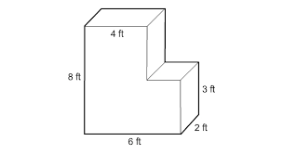
Find the volume of the shape below.
V of left = 64 ft³
V of right = 12 ft³
V entire shape = 76 cm³

Slide 4
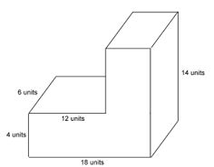
Find the volume of the shape below.
V of left = 288 units³
V of right = 504 units ³
V entire shape = 792 units³

Slide 5
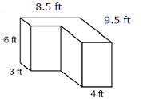
Find the volume of the shape below.
V of left = 81 ft³
V of right = 228 ft³
V entire shape = 309 ft³

