Slide 1
Surface Area Rectangular Prisms Rectangular Pyramids Triangular Prisms Triangular pyramids

Slide 2
Day 1 - Surface Area of Prisms
Surface Area = The total area of the surface of a three-dimensional object
(Or think of it as the amount of paper you’ll need to wrap the shape.)
Prism = A solid object that has two identical ends and all flat sides.
We will start with 2 prisms – a rectangular prism and a triangular prism.

Slide 3
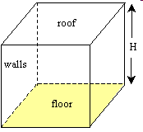
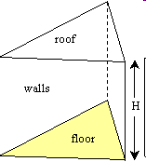
Rectangular Prism
Triangular Prism

Slide 4
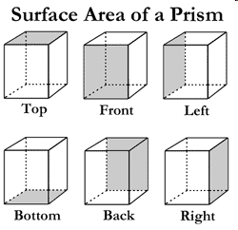
Surface Area (SA) of a Rectangular Prism
Like dice, there are six sides (or 3 pairs of sides)

Slide 5
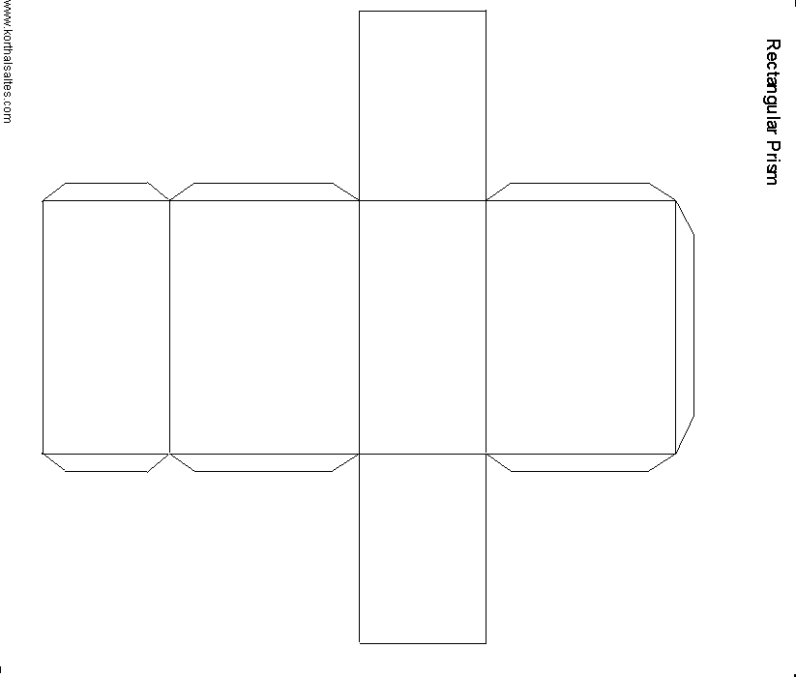
Prism net - unfolded

Slide 6
Practice
12 ft
10 ft
22 ft
SA = 2lw + 2lh + 2wh
= 2(22 x 10) + 2(22 x 12) + 2(10 x 12)
= 2(220) + 2(264) + 2(120)
= 440 + 528 + 240
= 1208 ft squared

Slide 7
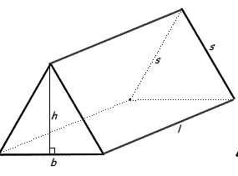
Surface Area of a Triangular Prism
2 bases (triangular)
3 sides (rectangular)

Slide 8
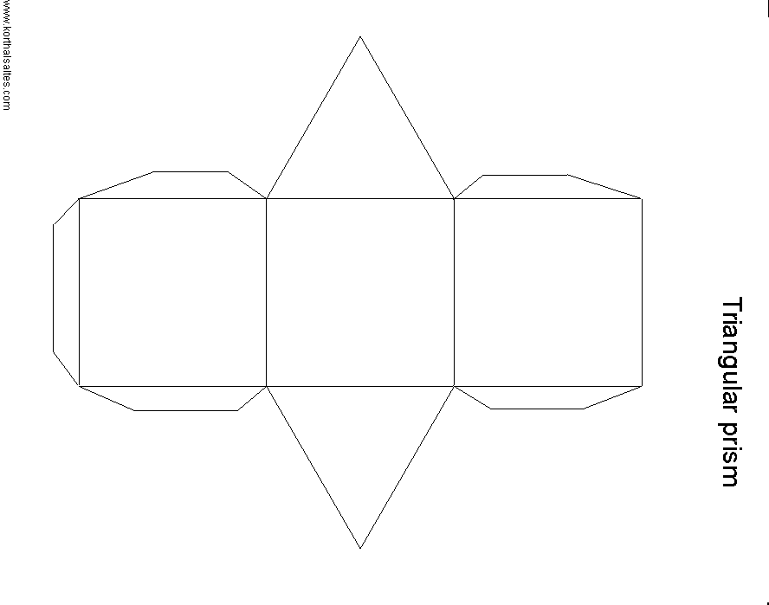
Unfolded net of a triangular prism

Slide 9
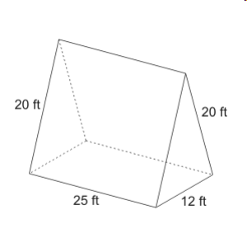
2(area of triangle) + Area of rectangles
Area Triangles = ½ (b x h)
= ½ (12 x 15)
= ½ (180)
= 90
Area Rect. 1 = b x h
= 12 x 25
= 300
Area Rect. 2 = 25 x 20
= 500
15ft
SA = 90 + 90 + 300 + 500 + 500
SA = 1480 ft squared

Slide 10
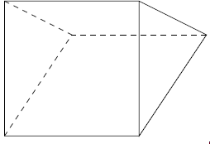
Practice
Triangles = ½ (b x h)
= ½ (8 x 7)
= ½ (56)
= 28 cm
Rectangle 1 = 10 x 8
= 80 cm
Rectangle 2 = 9 x 10
= 90 cm
Add them all up
SA = 28 + 28 + 80 + 90 + 90
SA = 316 cm squared
9 cm
7 cm
9 cm
8 cm
10 cm

Slide 11
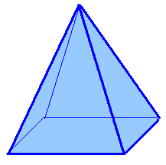
Surface Area of a Pyramid

Slide 12
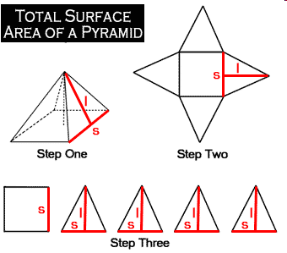
Pyramid Nets
A pyramid has 2 shapes:
One (1) square
&
Four (4) triangles

Slide 13
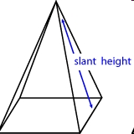
Since you know how to find the areas of those shapes and add them.
Or…

Slide 14
Practice
18
SA =
= ½ (6 x18) x 4+(6 x 6)
= ½ (432) + (36)
= 216 + 36
= 252 units²
10
6
6
Slant height = 18
What is the extra information in the diagram?

Slide 15
Find the S.A.
8
5
= ½ (7x 8) x 2 + ½ (6 x8) x 2 + (7 x 6)
= (56) + (48)+ (42)
= 104 + 42
= 146 units ²
6
7

