Slide 1
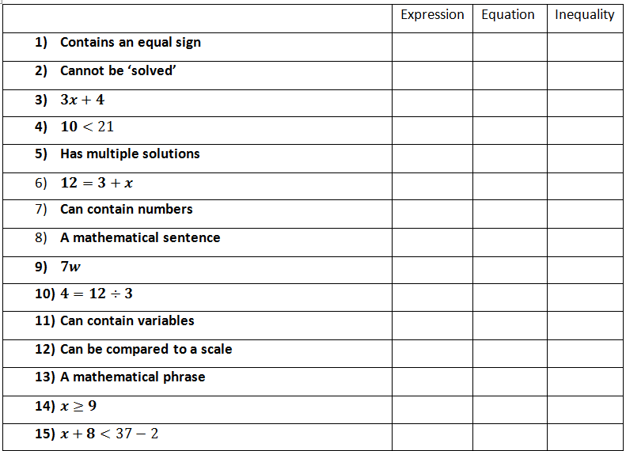
Homework 11/18

Slide 2
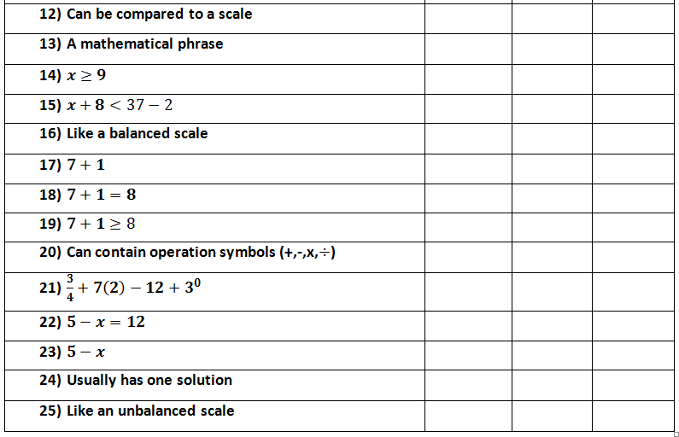
Homework 11/18

Slide 3
Identify Solution Sets
With algebraic equation or inequality can we determine if a given value is a solution? “Does it make the statement true?”
What is the next step after identifying Solutions????

Slide 4
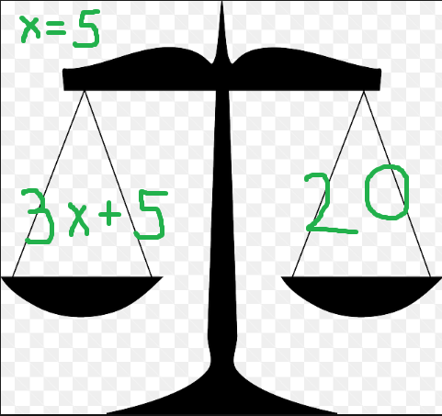

Slide 5
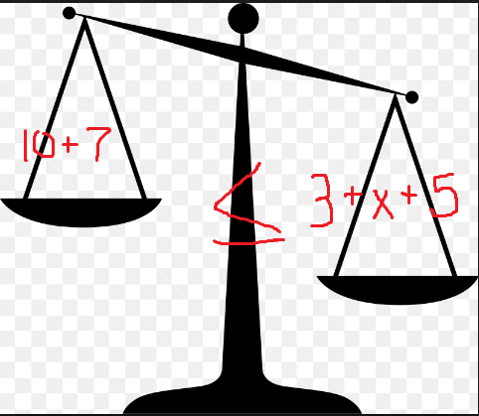

Slide 7
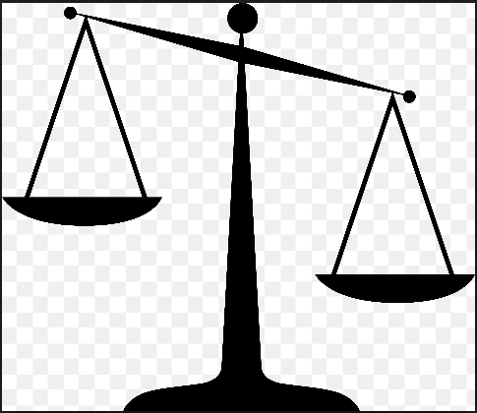

Slide 8
Is w+8+6w-3 ≤ 5, when w=0 ??

Slide 9
Does 79-8*j= 34+ j, when j=5 ???

Slide 10
Solving Equations (Keeping the scale balanced)
g + 1 =

