Slide 1
Do Now
1) 4a + 6(a+5) + 7
10a+37
2) 5x + x(4+x)
9x + x^2
Simplify

Slide 2
Unit 8: Equations and Inequalities Expressions vs Equations and Inequalities
Essential Question:
What is an equation and how is it similar and/or different from an expression?

Slide 3
Think, Pair, Share
3 + x + 2
Is the item above an expression, an equation or an inequality?
Is it possible to determine the value of x? Why or why not?
What other information would you need in order to determine the value of x?

Slide 4
Think, Pair, Share.
3 + x + 2 = 9
Can you now determine the value of x?
What changed?

Slide 5
Think. Pair. Share.
3 + x + 2 < 9
What about now?
Can you determine the value(s) of x?
What is different this time?

Slide 6
Discovery Education Video
https://www.youtube.com/watch?v=jRHoXoqCL80
While you watch the video try to determine if your three categories for the sorting activity are correct.
After viewing the video, decide with your group if you should rearrange your items into different categories.

Slide 7
Expressions, Equation and Inequalities Notes

Slide 8
Notes Continued

Slide 9
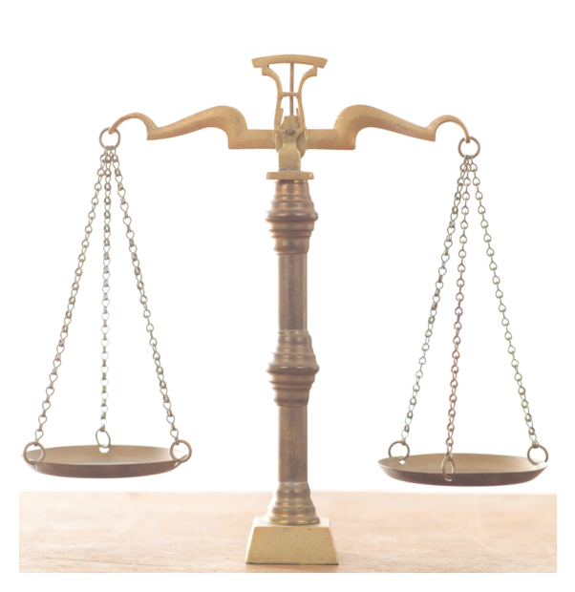
Equations Like a balanced scale
=
3 + x + 2
9
What value of x would make this balance?

Slide 10
Equations Like a balanced scale
=
3 + 5
5x - 2
Can you find the value of x?

Slide 11
Notes continued

Slide 12
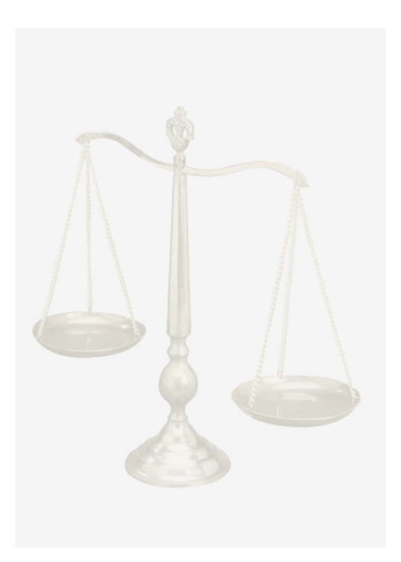
Inequalities Like an unbalanced scale
3 + x + 2
<
9
Can you find some possible values of x that make the statement true?

Slide 13

Challenge - Inequalities Like an unbalanced scale
$$\frac{12}{4}+4(3)$$
>
9m - 12
Challenge Problem: Can you find some possible values of m that make the statement true?

Slide 14
Language Arts Connection
Think of a word that completes this analogy
Expression is to Phrase as equation or inequality is to ___________

Slide 15
Language Arts Connection
Think of a word that completes this analogy
Expression is to Phrase as equation or inequality is to sentence!

Slide 16
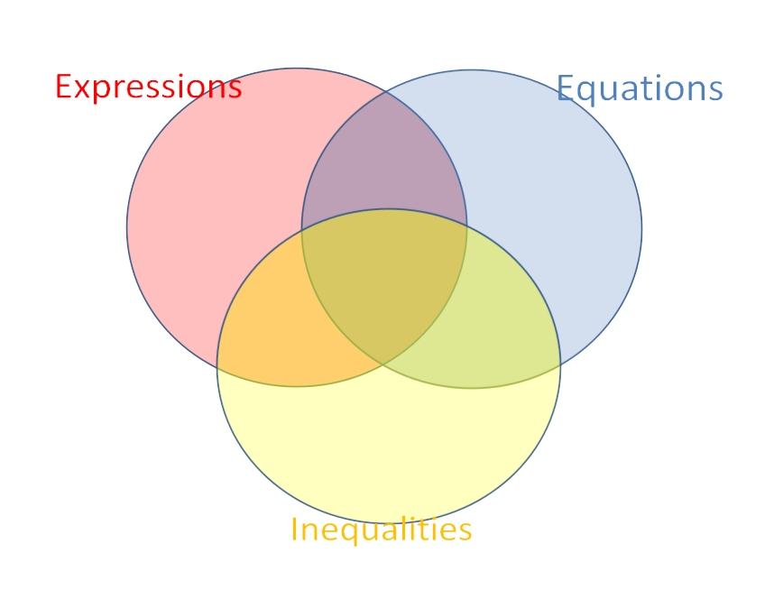
Put each characteristic to the appropriate spot in the Venn diagram
Has an equal sign
A mathematical phrase
A mathematical sentence
Can have numbers
Can be simplified
Like a balanced scale
Like a scale
Usually has one solution
Has no solutions
Cannot be solved
Can have +, -, x, ÷ signs
Has multiple solutions
Can have variables
Has >, <, ≥ or ≤ signs
Like an unbalanced scale
Can be solved

Slide 17
Solution

Slide 18
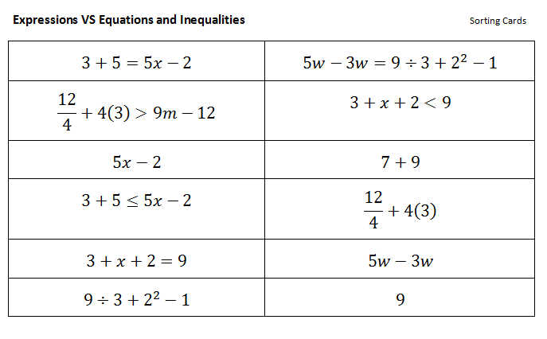
Sorting Activity: Exit Ticket
Look at the following items carefully. With your group decide how you would group the items if you had to separate them into three different categories.

Slide 19
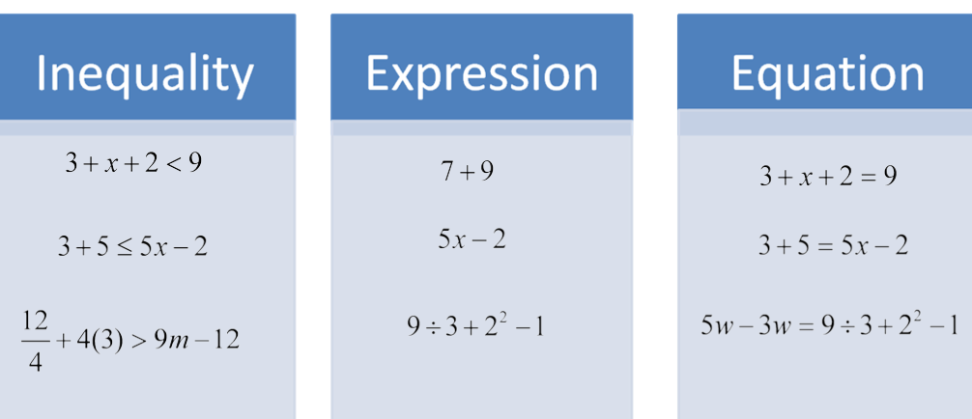
Card Sort
Let’s revisit the sorting card activity from earlier … did you have them all correct?

