Slide 1
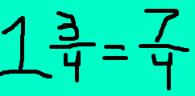
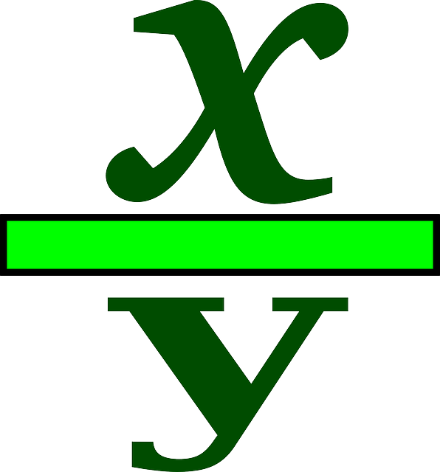
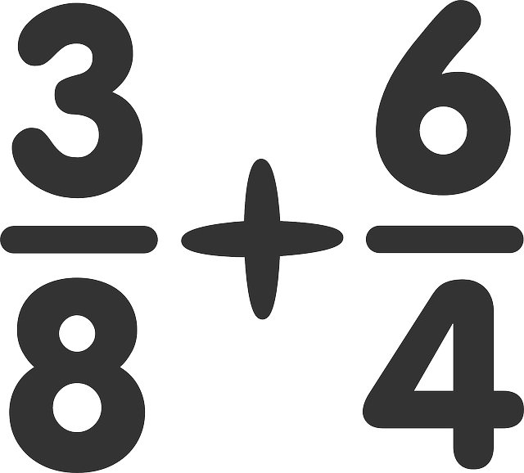
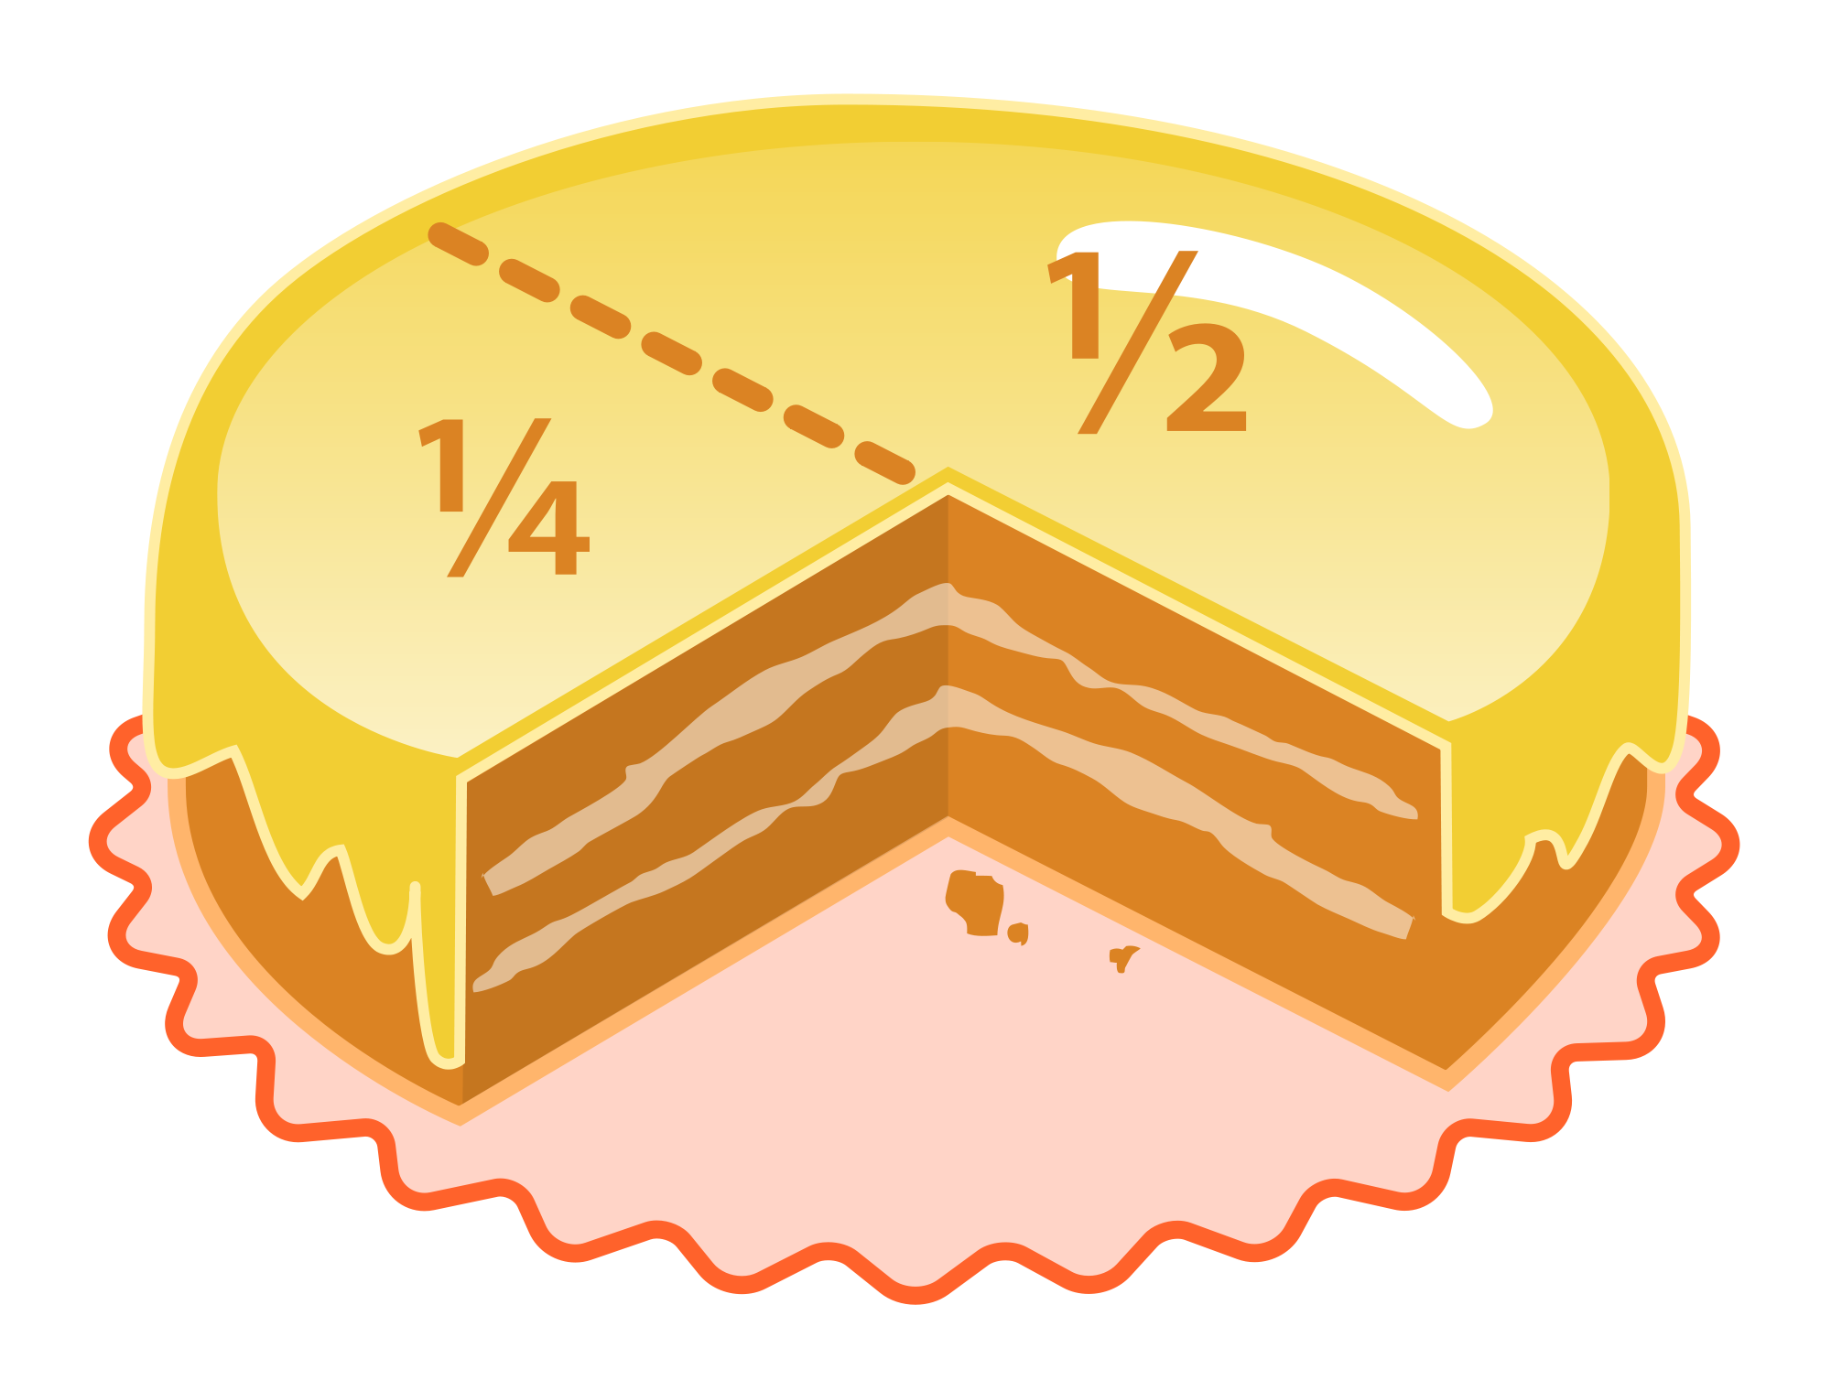
Fractions

Slide 2
Vocabulary
Denominator: The bottom number of a fraction that tells how many equal parts are in the whole
Numerator: The top number of a fraction that tells how many parts of a whole are being considered
Improper Fraction: A fraction in which the numerator is greater than or equal to the denominator
Mixed Number: A whole number that is not 0 and a proper fraction (1 3/4 )

Slide 3
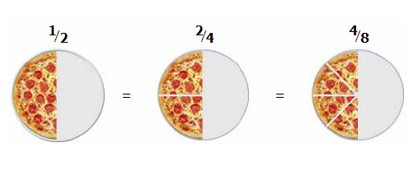
Equivalent Fractions
fractions that have the same value, even though they look different
Images from:https://www.risd.k12.nm.us/Addition_Fraction.pdf

Slide 4
Equivalent Fractions
Predict what the next fraction would be in this sequence of equivalent pizza fractions.

Slide 5
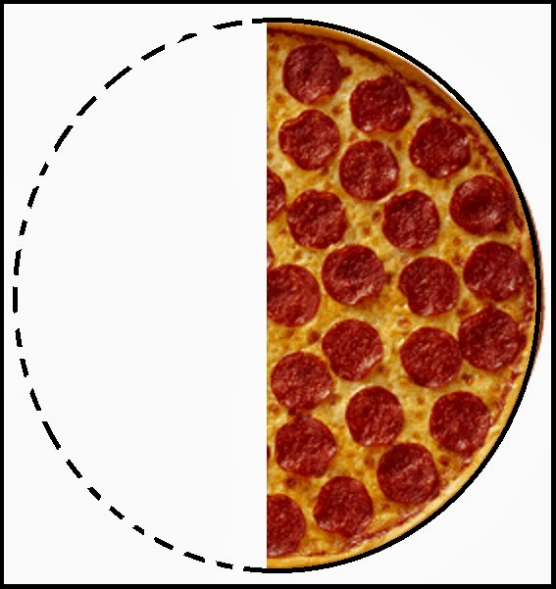
Equivalent Fractions

Slide 6
Simplifying Fractions
To simplify something means to make something Less Complicated.
Simplified fractions have only one common factor between the numerator and denominator (= 1), and is reduced to simplest form.

Slide 7
Simplified fractions and equivalent fractions
Simplifying fractions and finding equivalent fractions will help us when we start doing fraction operations (adding and subtracting).
Any ideas on how it may help us?
Notes:
finding common denominators and simplifying answer

Slide 8
Mixed Numbers and Improper Fractions
How are mixed numbers and improper fractions related?
Can I represent a mixed number as an improper fraction?
When would it make sense to use a mixed number instead of an improper fraction?
http://www.pbslearningmedia.org/resource/mwnet-math-nf-helpwan/adding-and-subtracting-with-unlike-denominators-help-wanted-for-bianca/
Notes:
Mixed numbers and improper fractions can be equivalently represented

Slide 9
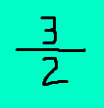
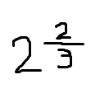
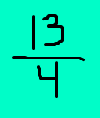
Mixed Number to Improper Fraction

Slide 10
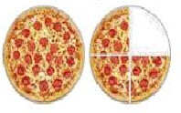
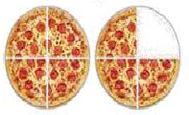
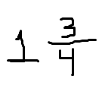
Mixed Numbers and Improper Fractions
How would we represent this equivalent improper fraction?
How would I represent this pizza as a mixed number?

Slide 11
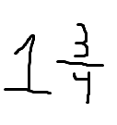
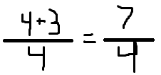
Converting mixed to Improper
Take the denominator of proper fraction and multiply it by the whole number out front.
Now take the product of your whole number and denominator and add it to the numerator
make this sum your NEW numerator and put it over the original denominator

Slide 12
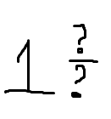
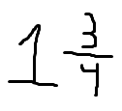
Convert Improper to Mixed Numbers
Divide the denominator into the numerator
Take how many times the denominator will go into the numerator and make that the whole number in front.
Now make your remainder the NEW numerator keep your denominator the same.

Slide 13
Independent Practice

Slide 14
