Slide 1
Fraction Multiplication
Understand the relationship between the factors and the product of a fraction multiplication problem
Understand that taking a portion of something is multiplying fractions
Perform the multiplication of fraction operations
Cross cancel when multiplying fractions
Model fraction multiplication

Slide 2
Multiply Fractions
So how do we multiply fractions?
Multiply the numerators by each other and the denominators by each other. The product of our numerators over the product of the denominators will be the product of our two fractions:

Slide 3
Multiplying Fractions
Examples
$\frac{3}{4}∗\frac{2}{15}$=
$\frac{2}{3}∗\frac{4}{9}=$
$\frac{4}{5} of\frac{6}{11} is ?$
One-half of three-fourths is equal to?

Slide 4
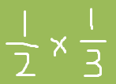
Multiplying Fractions
When we take a fraction OF something we want to multiply fractions.
Is the way to think of

Slide 5
Multiplying Fractions
Cross Cancelling to simplify our fraction product.

Slide 6
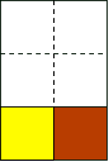
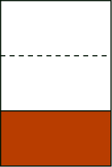
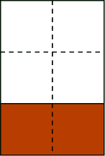
Example 1
Jordan got ¹⁄₃ of a chocolate bar from his sister. He ate ½ of it during lunch break and saved the rest for the evening. How much of a chocolate bar did he eat during lunch break?
Let us answer this question by drawing diagrams. (click)
¹⁄₃ of the whole
½ of ¹⁄₃
the whole piece of chocolate
From the last diagram, we see that the yellow piece he ate is equal to 1 out of 6 from the whole bar. Therefore ½ of ¹⁄₃ is ¹⁄_{6 .}

Slide 7
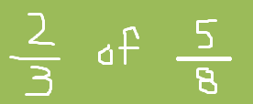
Multiplication of Fractions
Examples 2
On the other day, Jordan got ⁵⁄₈ of a chocolate bar from his mom and he gave ²⁄₃ of that to his younger brother.
whole piece of chocolate

Slide 8
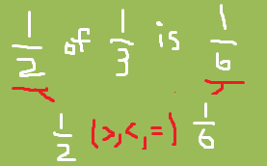
Multiplying Fractions
Based on the previous two examples how does what I have from the beginning compare to what I have at the end?
?

Slide 9
Multiplying Fractions
Multiplication is also known as repeated __________?
$Ex: 5∗\frac{1}{3}=\frac{1}{3}+\frac{1}{3}+\frac{1}{3}+\frac{1}{3}+\frac{1}{3}= \frac{5}{3}$
-If I give you the repeated addition can you give me the multiplication problem?
Lets try this one:

