Slide 1
DO NOW:
1) What is the distributive property?
(Use your notes)
2) Explain the difference between the identity property and the zero property.

Slide 2
Distributive Property
The Distributive property says that multiplying a number by a group of numbers added/subtracted together is the same as doing each multiplication separately.

Slide 3
Lets look at an Area model…
Example: 3 × (2 + 4) = 3×2 + 3×4 So the "3" can be "distributed" across the "2+4" into 3 times 2 and 3 times 4.

Slide 4
BRAIN POP!

Slide 5
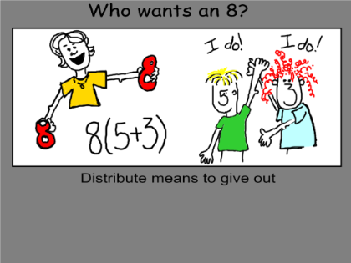
8 3
8(5+3)
= (8 5)
+ (8 3)
8 5

Slide 6
Examples
7(3+11)
= 21 + 77 = 98
9(10-2)
= 90 – 18 = 72
x(3+2)
= 3x + 2x
4(y-5)
= 4y - 20

Slide 7
Examples
x(z+11)
= xz + 11x
2(p-2)
= 2p - 4
m(n+r)
= mn + mr
a(b-c)
= ab - ac

Slide 8
QUESTIONS?

