Slide 1
Area
2.29.16

Slide 2
Area
Area is the amount of space a figure takes up.
Area is given in squared units.

Slide 3
Area of a Square
A square has four congruent sides.
To find the area of a square, one will need to multiply the length x width.
Example:
Find the Area:
Length X Width = Area
3 x 3= 9 inches ²
3 inches

Slide 4
Find the Area of the SQuare
Width = 3.2 m
Area of the Square = Length X Width
3.2
X 3.2
64
960
10.24 centimeters squared

Slide 5
Area of a Rectangle
Like a square, you can find the area of a rectangle by multiplying length by width.
Example:
Find the Area of the Rectangle:
Length X Width = Area
13 ½ X 9 =
9 m
13 ½ m
27/2 x 9 = 243/2
121 ½ meters ²

Slide 6
Area of a Rectangle
The garden bed in my backyard has an area of 52 square meters. The width of the garden bed is 4 meters. What is the length of the garden bed?
Area = Length x Width
52 = L x 4
÷4 ÷4
13 meters = L

Slide 7
Triangles
Area of a Triangle= ½ Base x Height or ½ (b x h)
hypotenuse
height
height
base
base

Slide 8
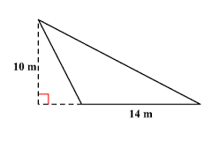
Find the Area of the Triangle
Area = ½ Base x Height
Area = ½ (10) x (14)
Area = 5 x 14
Area = 70 meters ²

Slide 9
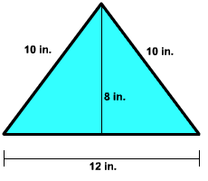
Area of a Triangle
Area = ½ Base x Height
Area = ½ (12) x (8)
Area = 6x 8
Area = 48 meters ²

Slide 10
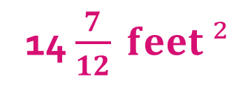
Solve the Following
1) A square has an area of 64 square yards. What are the dimensions of the square?
2) The fireplace in Lia’s living room has a width of 3 $\frac{1}{8}$ feet and a length of 4 $\frac{2}{3}$ feet. What is the total area of space the fireplace takes up on the living room wall?
Length= 8 yards Width = 8 yards
14 $\frac{7}{12} feet ²$

