Slide 1
Adding and Subtracting Fractions & Mixed Numbers
http://pbskids.org/cyberchase/videos/cyberchase-inez-gets-her-groove-back/

Slide 2
Adding and Subtracting Fractions
To add or subtract fractions we must first have common denominators.
We use what we know about finding the Least Common Multiple and apply it to finding two common denominators----LEAST COMMON DENOMINATORS
Once you have the common denominators, multiply the numerators by the factor which gives you the new denominator.
Add or subtract your new numerators and keep denominator the same in our sum/difference. SIMPLIFY ANSWER IF NECESSARY

Slide 3
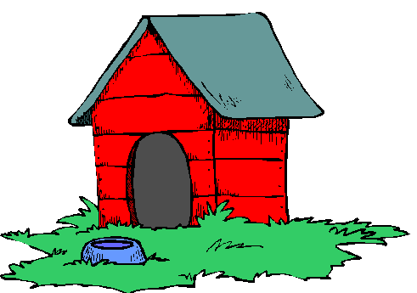
Adding and Subtracting Fractions
Kennedy is using a piece of plywood to build her new puppy a dog house. She has used five-eighths of the plywood to build the roof and one-seventh of her plywood to build the walls. What fraction of her plywood does she have left to build the floor?

Slide 4
Adding and Subtracting Fractions
three-fourths as a sum of two uncommon denominators
one-fifth as a difference of two proper fractions with common denominators ( but not 5)
four twenty-firsts as a sum of two fractions w/ uncommon denominators
four twenty-firsts as a difference of two fractions w/ uncommon denominators
one and seven-twelves as a sum of two proper fractions with unlike denominators

