Slide 1
Integers
ABSOLUTE VALUE

Slide 2
The History of Negative Numbers
Some of our earliest mathematicians were merchants and tax collectors.
The first negative number was introduced by a Chinese tax collector in 200 B.C. Why do you think he may of had to deal with negative numbers??
Now that we had negative numbers this created problems for some. Especially those who dealt with maps… Can we think of why this may be a problem?

Slide 3
To answer to the Problem: ABSOLUTE VALUE
The help with this issue mathematicians created what we call ABSOLUTE VALUE. The ABSOLUTE VALUE of a point on a number line is equal to the distance of that point from 0.

Slide 4
Human Number Line
Volunteers to be integers on the number line
Volunteers to be my plotted points.
abs -3 and abs 3
abs-5 and abs 5
abs-5 and abs3

Slide 5
Absolute Value in Order of Operations
In an order of operations situation treat absolute value like parenthesis:

Slide 6
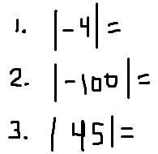
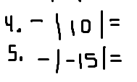
Try Some on Your Own

Slide 7
Ordering with Absolute Value
Order from least to greatest

Slide 8
Opposites
Two numbers that have the same ABSOLUTE VALUE, but different signs are called opposites.
Example -6 and 6 are opposites because both are 6 units away from zero.
| -6 | = 6 and | 6 | = 6
-7 -6 -5 -4 -3 -2 -1 0 1 2 3 4 5 6

Slide 9
Opposites
What is the opposite?
-10
-35
12
100
1
X

